Slide 1
Web Engineering (CSC336) Enterprise Systems Development (CSC447)
Dr. Maaz Rehan

Slide 2
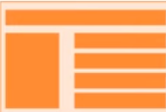
How Does Web Work?
Web Page
USER
HTML
BROWSER
CSS
Enter a URL
www.google.com
request
DNS server
Translates domain
to IP
response
Server
Stores or generate website

Slide 3
Course Pathway
!! Lets be friendly, honest and dedicated while learning & delivering !!
We shall develop Front-end of websites using:
HTML (Hypertext Markup Language) and HTML 5
CSS (Cascading Style Sheets) and CSS 3
Bootstrap 4
We shall develop Back-end of websites using:
Laravel which is Framework of PHP
We shall use MySQL as Database Management System (DBMS)
Web Development Roadmaps: https://www.w3schools.com/whatis/default.asp

Slide 4
Week 1

Slide 5

HTML (Hyper Text Markup Language)
NOT a programming language with logic
HTML is a standard markup language for displaying pages in web browser
Markup languages use tags to define elements within a document
Tags are human readable commands (standard words)
HTML is assisted by styling technologies (e.g. CSS) and scripting languages (e.g. JavaScript)

Slide 6
Learning Resource
Online Code Editor: https://www.w3schools.com/tryit/default.asp
HTML: https://www.w3schools.com/html/default.asp
CSS: https://www.w3schools.com/css/default.asp
Bootstrap: https://www.w3schools.com/bootstrap/bootstrap_ver.asp
PHP: https://www.w3schools.com/php/default.asp
Note: Class slides would contain material from the above URLs.

Slide 7

HTML Tags, Attributes and Elements
When working with HTML, we use simple code structures (tags and attributes) to mark up a website page.

Slide 8
HTML Tags
A keyword written between angle brackets <xyz> is called a tag
Start tag is like <xyz> while end tag is like </xyz>
HTML tags are hidden keywords that control formatting of a web page in the browser and define the display of content
Most tags have both start and end. Few tags only have start
Anything within the start/end tag is called content
<h1> A Heading </h2>

Slide 9
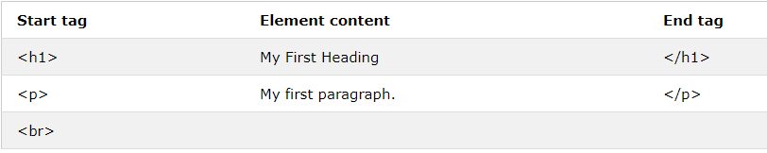
HTML Elements
The HTML element is everything from the start tag to the end tag.

Slide 10
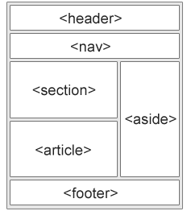
HTML Layout Elements
<header> Defines a header for a document or a section
<nav> Defines a container for navigation links
<section> Defines a section in a document
<article>
Defines an independent self-contained article
<aside>
Defines content aside from the content (like a sidebar)
<footer>
Defines a footer for a document or a section
<details>
Defines additional details
<summary>
Defines a heading for the <details> element

Slide 11
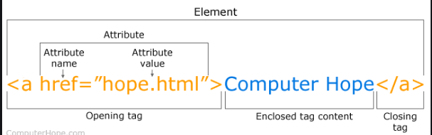
HTML Attributes
An attribute defines one property for an element
It consists of a name/value pair, and appears within the element's start tag.
Start tag may contain any number of name/value pairs separated by spaces.

Slide 12
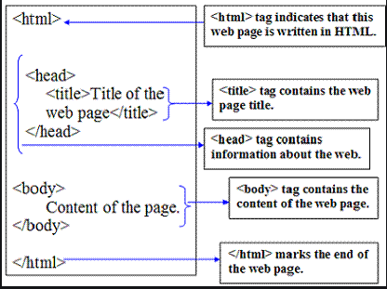
Structure of HTML Document
<!DOCTYPE html> declaration tag defines this document to be HTML5
<html> element is the root element of an HTML page
<head> element contains meta information about the document
The <title> element specifies a title for the document
The <body> element contains the visible page content
The <h1> element defines a large heading
The <p> element defines a paragraph

Slide 13
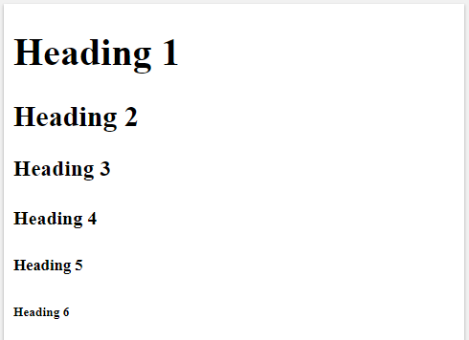
HTML Tags – Heading
<!DOCTYPE html>
<html>
<body>
<h1>Heading 1</h1>
<h2>Heading 2</h2>
<h3>Heading 3</h3>
<h4>Heading 4</h4>
<h5>Heading 5</h5>
<h6>Heading 6</h6>
</body>
</html>
Output

Slide 14
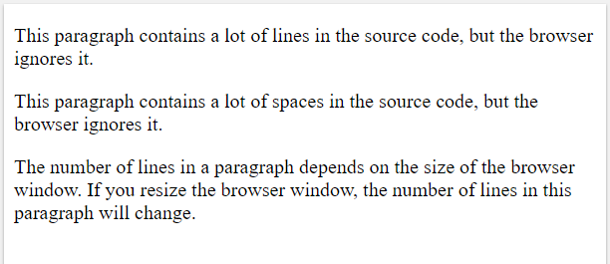
HTML Tags – Paragraph
Output
<body>
<p>
This paragraph contains a lot of lines
in the source code, but the browser
ignores it.
</p>
<p> This paragraph contains a lot of spaces
in the source code, but the browser ignores it. </p>
<p> The number of lines in a paragraph depends on the size of the browser window. If you resize the browser window, the number of lines in this paragraph will change. </p>
</body>

Slide 15
HTML Tags – Image
<img src="url">
It is empty (no content), so only attributes and no closing tag
Example (Paste the following code within HTML <body> tag)
<img src=“cui.jpg" alt=“COMSATS University" width="500" height="333">
If a browser cannot find an image, it will display the value of the alt attribute

Slide 16
HTML Tags – Links (called anchor tag)
<a href="url">link text</a>
<a> element defines a link
href attribute defines link address
target attribute defines which page to open. (i) “_blank” opens in new window, (ii) “_self” opens the page in same window.
<img> element (inside <a>) uses an image as a link
id attribute (id="value") defines bookmarks in a page
href attribute (href="#value") links to the bookmark on the page
Example (Paste the following code within HTML <body> tag)
<a href="http://wah.comsats.edu.pk/" target=“_self”> Visit CUI Wah Campus </a>
<a href="http://wah.comsats.edu.pk/">
<img src=“cui.jpg" alt=“COMSATS University” width="500" height="333"> </a>

Slide 17
HTML Tags – Links (create a Bookmark)
2- Then, add a link to the bookmark ("Jump to Section 4"), from within the same page
<!DOCTYPE html>
<html>
<body>
<p><a href="#S4">Jump to Section 4</a></p>
<h2>Section 1</h2>
<p>This chapter explains HTML</p>
<h2>Section 2</h2>
<p>This chapter explains CSS</p>
<h2>Section 3</h2>
<p>This chapter explains PHP</p>
<h2 id=“S4">Section 4</h2>
<p>This chapter explains Laravel Framework</p>
</body>
</html>
1-create a bookmark with the id attribute

Slide 18
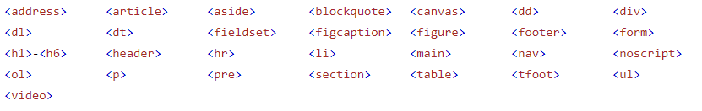
HTML Block-level Elements
A block-level element always starts on a new line and takes up the full width available (stretches out to the left and right as far as it can).

Slide 19
HTML Tags - Tables
<table> element defines a table
<tr> element adds a table row
<th> element defines column heading
<td> element defines a column data
<!DOCTYPE html>
<html>
<body>
<h2> HTML Table</h2>
<table>
<tr>
<th> University </th>
<th> Location </th>
<th> Rank </th>
</tr>
<tr>
<td> CUI Wah </td>
<td> Wah Cantt </td>
<td> 1 </td>
</tr>
<tr>
<td> UOW </td>
<td> Wah Cantt </td>
<td> 2 </td>
</tr>
<tr>
<td> IIUI </td>
<td> Islamabad </td>
<td> 2 </td>
</tr>
</table>
</body>
</html>

Slide 20
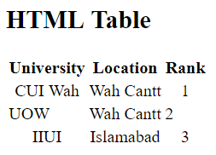
HTML Tags – Tables (output)
<!DOCTYPE html>
<html>
<body>
<h2> HTML Table</h2>
<table>
<tr>
<th> University </th>
<th> Location </th>
<th> Rank </th>
</tr>
<tr align=“center”>
<td> CUI Wah </td>
<td> Wah Cantt </td>
<td> 1 </td>
</tr>
<tr>
<td> UOW </td>
<td> Wah Cantt </td>
<td> 2 </td>
</tr>
<tr align=“center”>
<td> IIUI </td>
<td> Islamabad </td>
<td> 2 </td>
</tr>
</table>
</body>
</html>
Output

Slide 21
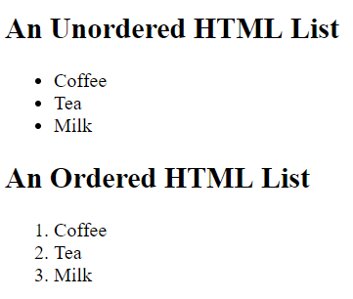
HTML Tags – Lists (ordered, unordered)
<!DOCTYPE html>
<html>
<body>
<h2>An Unordered HTML List</h2>
<ul>
<li> Coffee </li>
<li> Tea </li>
<li> Milk </li>
</ul>
<h2>An Ordered HTML List</h2>
<ol>
<li> Coffee </li>
<li> Tea </li>
<li> Milk </li>
</ol>
</body>
</html>
Output

Slide 22
HTML Style Attribute used in Tags
<tagname style="property:value;">
style attribute used for styling an HTML elements
background-color property used for background color
color property for text colors
font-family property for text fonts
font-size property for text sizes
text-align property for text alignment

Slide 23
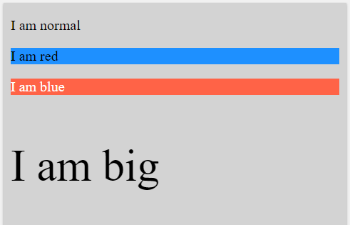
HTML Tags – Style
<body style="background-color:lightgray;">
<p>I am normal</p>
<p style="background-color:DodgerBlue;">I am red</p>
<p style="color:white; background-color:tomato;">I am blue</p>
<p style="font-size:50px;">I am big</p>
</body>
Output

Slide 24
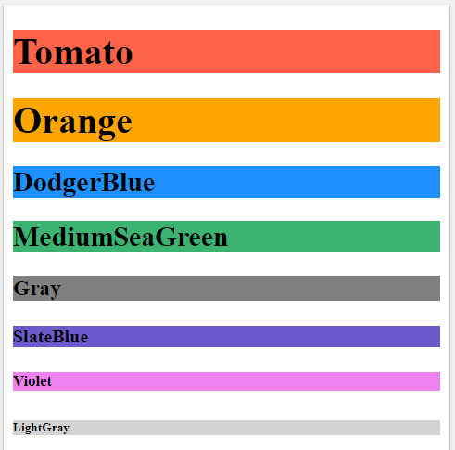
HTML Tags – Heading (with style)
Output
<!DOCTYPE html>
<html>
<body>
<h1 style="background-color:Tomato;">Tomato</h1>
<h1 style="background-color:Orange;">Orange</h1>
<h2 style="background-color:DodgerBlue;">DodgerBlue</h2>
<h2 style="background-color:MediumSeaGreen;">MediumSeaGreen</h2>
<h3 style="background-color:Gray;">Gray</h3>
<h4 style="background-color:SlateBlue;">SlateBlue</h4>
<h5 style="background-color:Violet;">Violet</h5>
<h6 style="background-color:LightGray;">LightGray</h6>
</body>
</html>

Slide 25
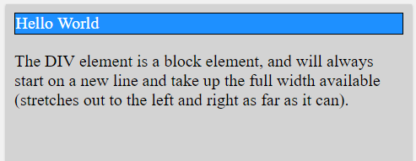
HTML Tags – div
<body style="background-color:lightgray;">
<div style="border: 1px solid black; color:White; background-color:DodgerBlue;">Hello World</div>
<p>The DIV element is a block element, and will always start on a new line and take up the full width available (stretches out to the left and right as far as it can).</p>
</body>
Output

Slide 26
HTML Tags – Form, Fieldset, Label, Text, Button
<body>
<h2>Grouping Form Data with Fieldset</h2>
<form action="/action_page.php" method="post">
<fieldset>
<legend>Personal Info:</legend> name="gender"
<label for=“fullname">Full Name:</label><br>
<input type="text" id=“fullname" name=“fullname" value="Maaz Rehan"><br><br>
<label >Gender</label><br>
<input type="radio" name="gender" id="male" value="male">
<label for="male">Male</label><br>
<input type="radio" name="gender" id="female" value="female">
<label for="female">Female</label><br>
<input type="radio" id="other" name="gender" value="other">
<label for="other">Other</label> <br> <br>
<input type="submit" value="Submit">
</fieldset> </form>
</body>
1- An input field must have name attribute
2- The for field of label can be bound to an element by giving it same value as given to the id of other element.

Slide 27
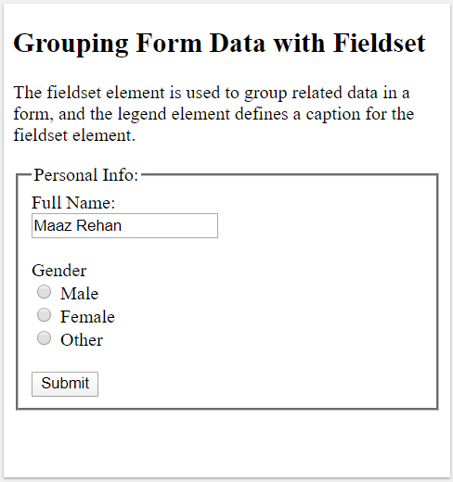
HTML Tags – Form… (output)

Slide 28
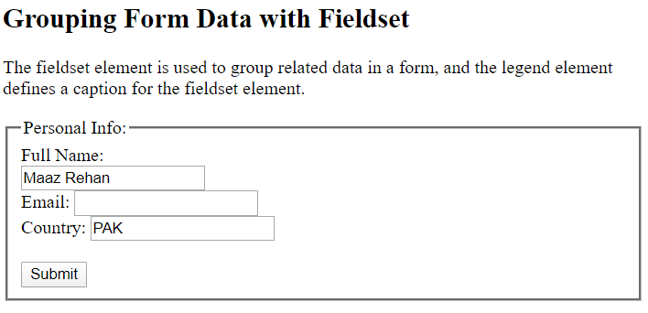
HTML Tags – Forms (Validations)
<form action="/action_page.php" method="post">
<fieldset>
<legend>Personal Info:</legend>
<label for="name">Full Name:</label><br>
<input type="text" id="name" name="name"
value="Maaz Rehan"><br>
Email: <input type="text" name="email"
required><br>
Country: <input type="text" name="country"
value="PAK" readonly><br><br>
<input type="submit" value="Submit">
</fieldset>
</form>

Slide 29
Assignment 01
Create an admission form for CUI using HTML elements
Use every useful and innovative HTML element in your form including:
Tables
Lists
Dropdowns (select)
Article
Column
Multimedia (audio, video)
and others, (keeping in mind that your form is better than others!!!)
Perform all type of validation checks (e.g. on the input fields)
Deadline: Bring complete HTML form in the next class for discussion

